Slide 1
K-type thermocouple
Naneng 203: electric circuit
Presented to: Dr.Ahmed Sayed Abdrabou
Team: Ziad haitham, Toqa Tarek, Ali Ehab, Wafaa Sherif

Slide 2
Content
1. Intro
2. Acquiring signal and displaying it
3. Signal analysis
4. Circuit design #1
5. Circuit design #2
6.Circuit design #3
7. Circuit design ( hardware)
8.Spectrum of Signal

Slide 3

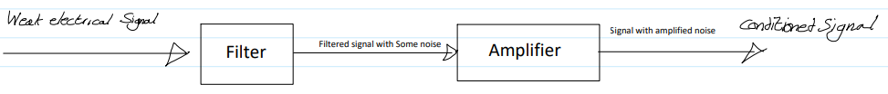
Intro
problem : measuring temperature accurately as thermocouple produce small voltage signals and may exhibit smaller voltage changes with temperature.
Solution: low-pass filter

Slide 4
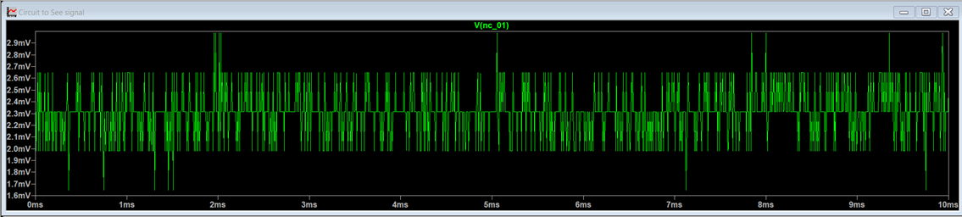
Acquiring the signal and displaying it:
Analog discovery - Thermocouple
Very low voltage, about 2.6 mV.

Slide 5
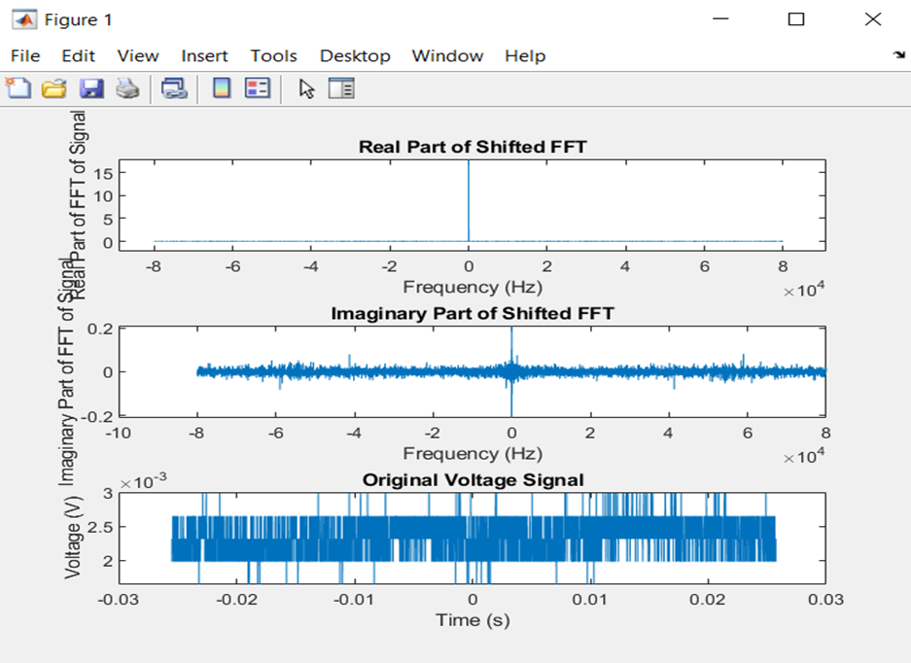
Signal Analysis:
Greatest magnitude with temperature data (desired signal)
Rest to be filtered
FFT(time domain → frequency domain)

Slide 6
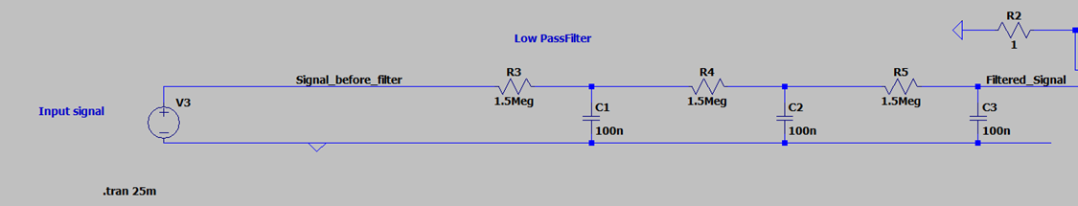
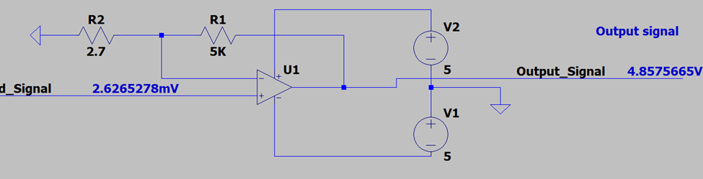
Circuit design#1:

Slide 7
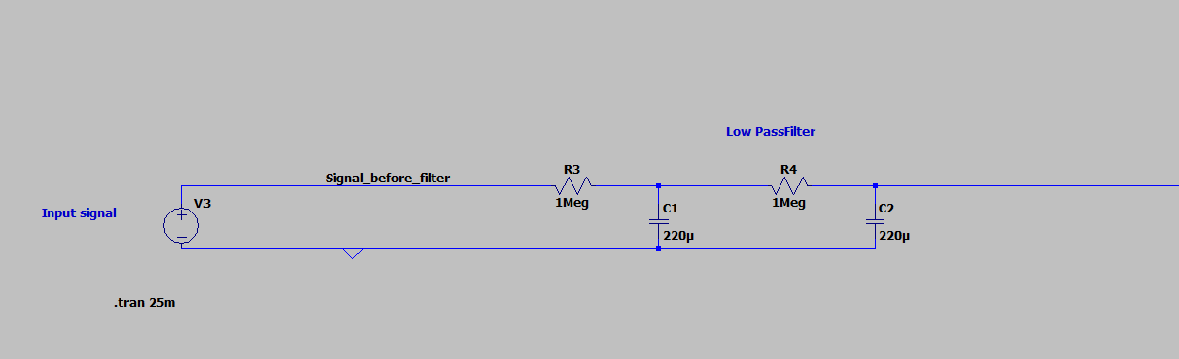
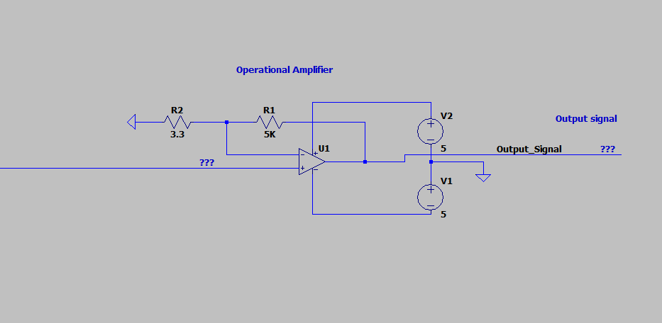
Circuit design#2:

Slide 8
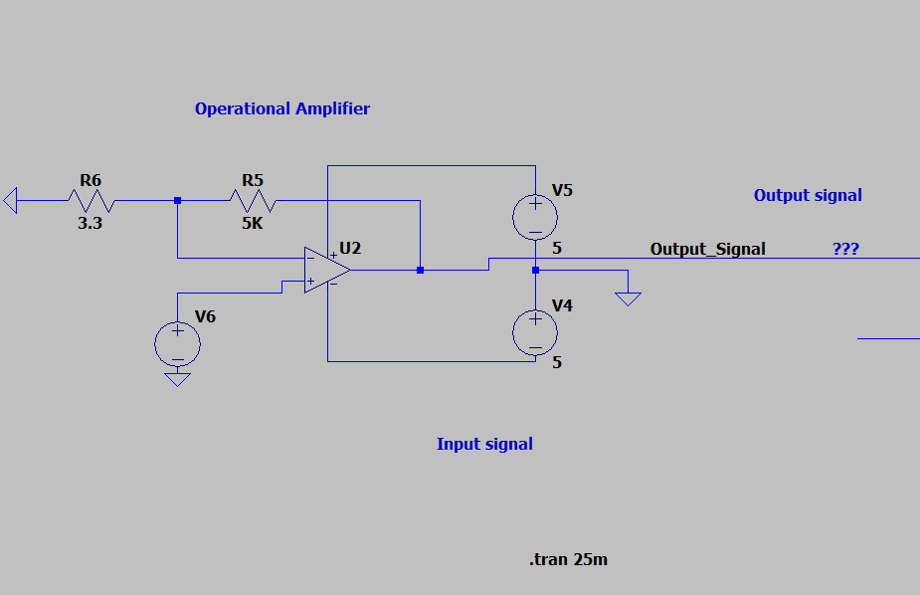
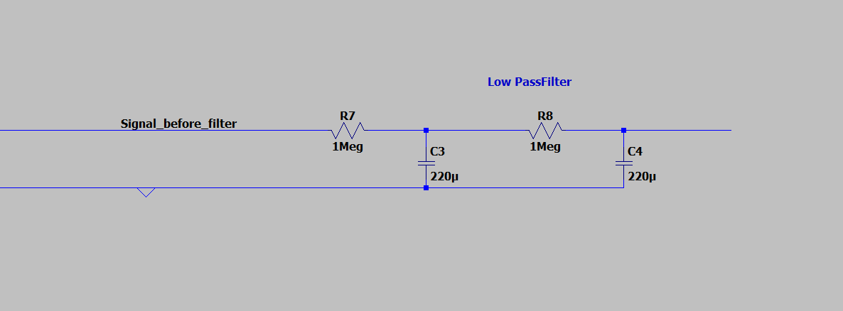
Circuit design#3:

Slide 9
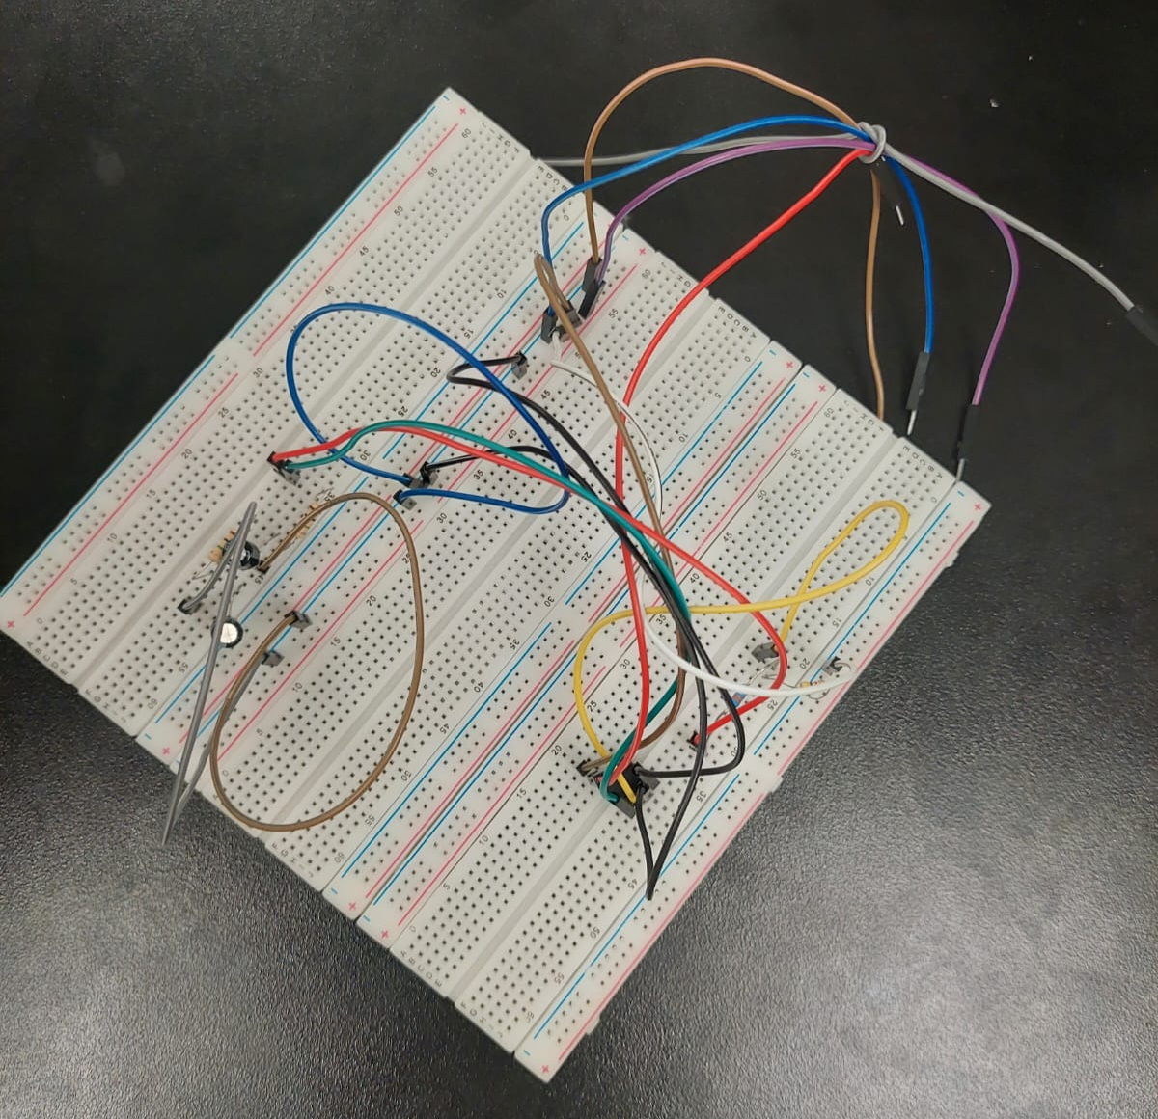
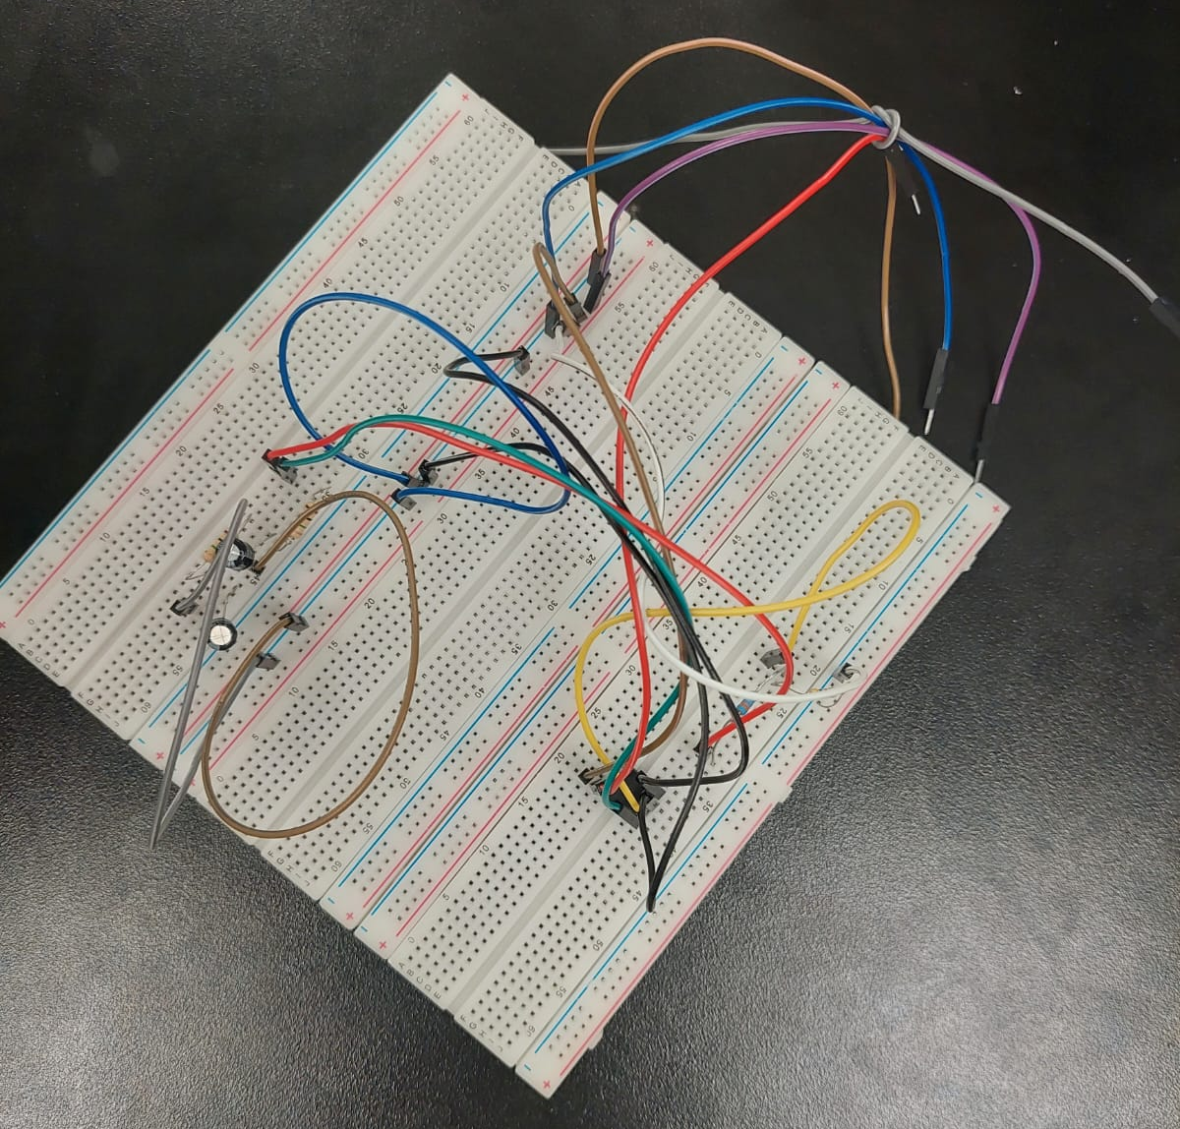
Circuit Design

Slide 10
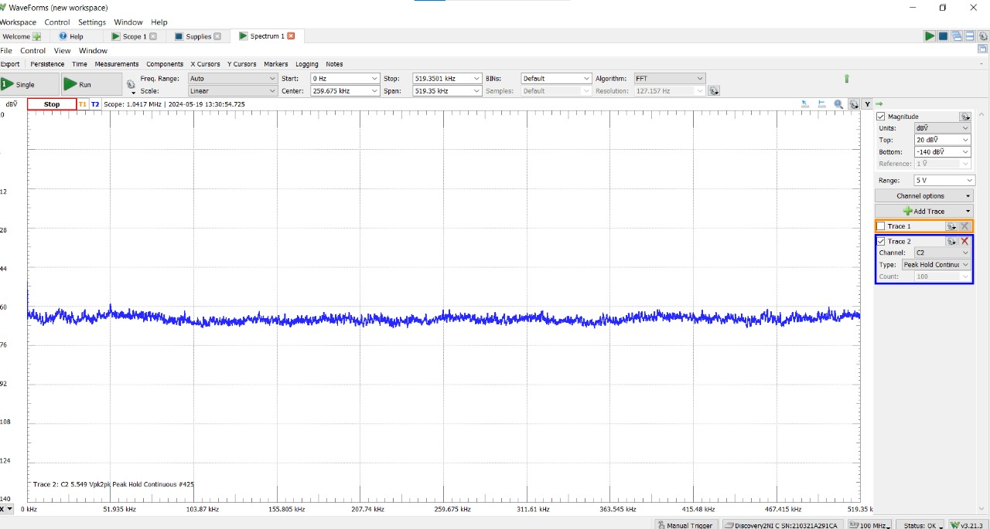
Spectrum of signal:
j[“Input signal”

Slide 11
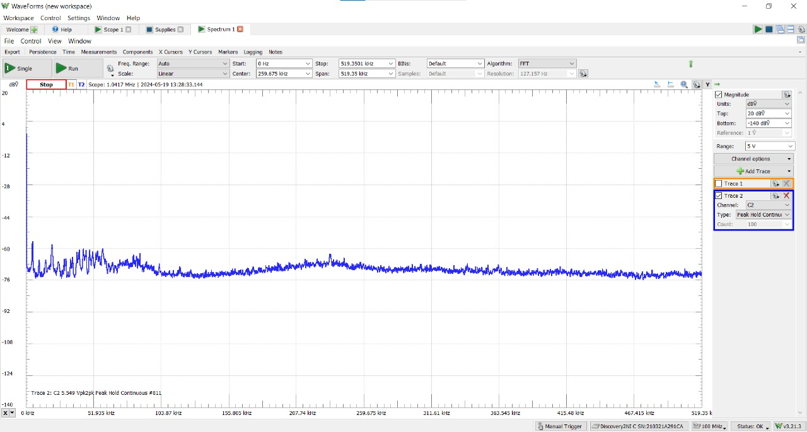
Spectrum of signal:
J[“Amplified signal ”

Slide 12
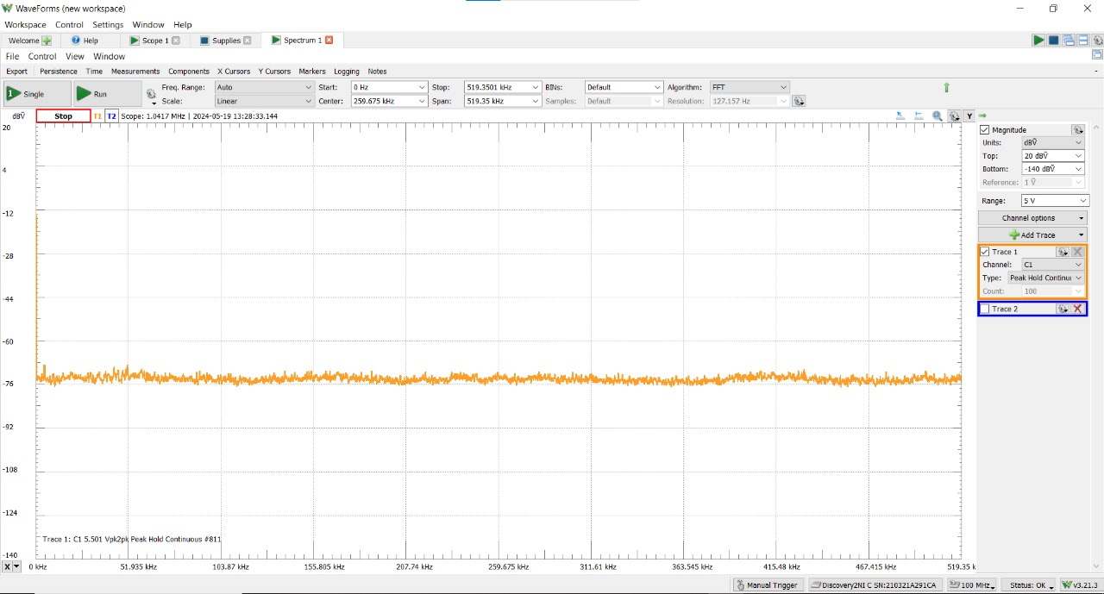
Spectrum of signal:
J[“output signal(after amplification and filtration)”

Slide 13
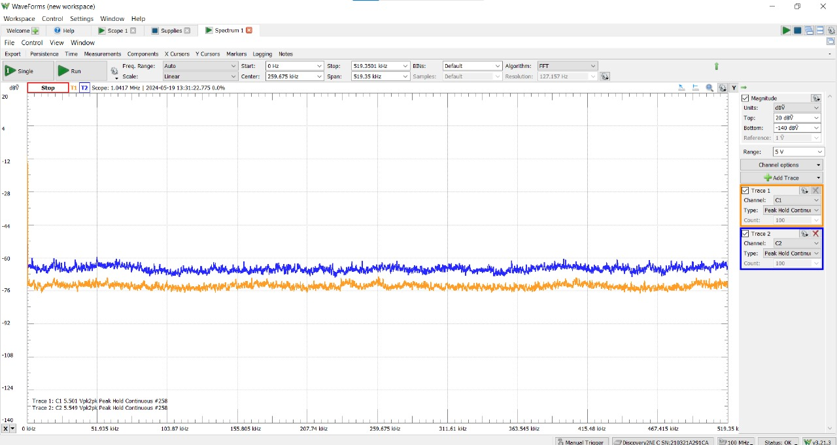
Spectrum of signal:
j[“Input signal vs. Output signal ”

Slide 14
Thank you

